Slide 1


BLETCHLEY PARK 2022
A Microsoft 365 Community COLLABORATION CONFERENCE
Wednesday, 5th October 2022
Bringing non-Microsoft content to your Search and…soon…Viva Topics
Kevin McDonnell

Slide 2







Kevin McDonnell
Head of Practice – Modern Workplace at CPS
18 years experience with SharePoint, Office 365 and friends.
16 years experience in Financial Services, 7 years working on the consulting side.
User group and conference speaker
GreyHatBeardPrincess podcast co-host
Viva Explorer
@kevmcdonk
/kevmcdonnell
/kevmcdonk

Slide 3

Agenda
What can you do with Microsoft Search
Ingesting content – standard and custom
Custom integration
Setting it up
Using Azure Logic Apps
What the user sees
The roadmap
Notes:
Intro
What can search do
Ways to extend
Focus on custom integration
Talk about graph points
How to host in azure
Schema
Permissions
Running in Logic apps
Viewing results
CLI commands
Chat about verticals
What’s on search roadmap
Chat about knowledge

Slide 4
What is Microsoft Search?
And what can you do with it?

Slide 5

in Bing
in Office.com
in SharePoint
in Edge
in Windows
Microsoft Search
One capability.
Every search experience.
in PowerPoint
in Outlook
in OneDrive
in Stream
in Yammer
in Word
in Teams
in OneNote
Microsoft Graph + Bing technology
*Slide from Ignite 2019
Notes:
This slide came from the Ignite in 2019 and it shows that Microsoft Search is all about that same search experience across Microsoft 365. The vision is to be able to use the same index, the same service, the same AI services for all Microsoft 365 services. In PowerPoint and looking for content? See the same from Word or SharePoint. Looking to get your emails from Bing? That too. Want to find the last Teams message from within Windows? That’s the plan.

Slide 6
Search in Microsoft 365
Microsoft Search
vs
SharePoint Search
Notes:
So is it just SharePoint Search extended? Many of you will have come from the SharePoint world and know how powerful SharePoint Search can be. However, it’s actually built on top of the Bing technology. Does that mean that SharePoint Search disappears? Actually, far from it.

Slide 7

Microsoft Search Architecture
Client Applications
Search Admin
Outlook/OWA
SharePoint
Office.com
Teams
Bing
Windows
Edge
Microsoft Search Service
Graph
Connectors
Ingestion Service
External Data
Sources
Azure Active Directory
External Content
SharePoint Files & Sites
Teams
Chats
Answers
Emails, Calendar
People, Tasks
Notes:
Instead, SharePoint Search becomes one of the sources for the search service. It is then indexed to the central service along with Office.com, Outlook, Teams, Bing, etc. But it doesn’t stop there. Most of this talk will be about bringing in your other content. What will you actually see though?

Slide 8
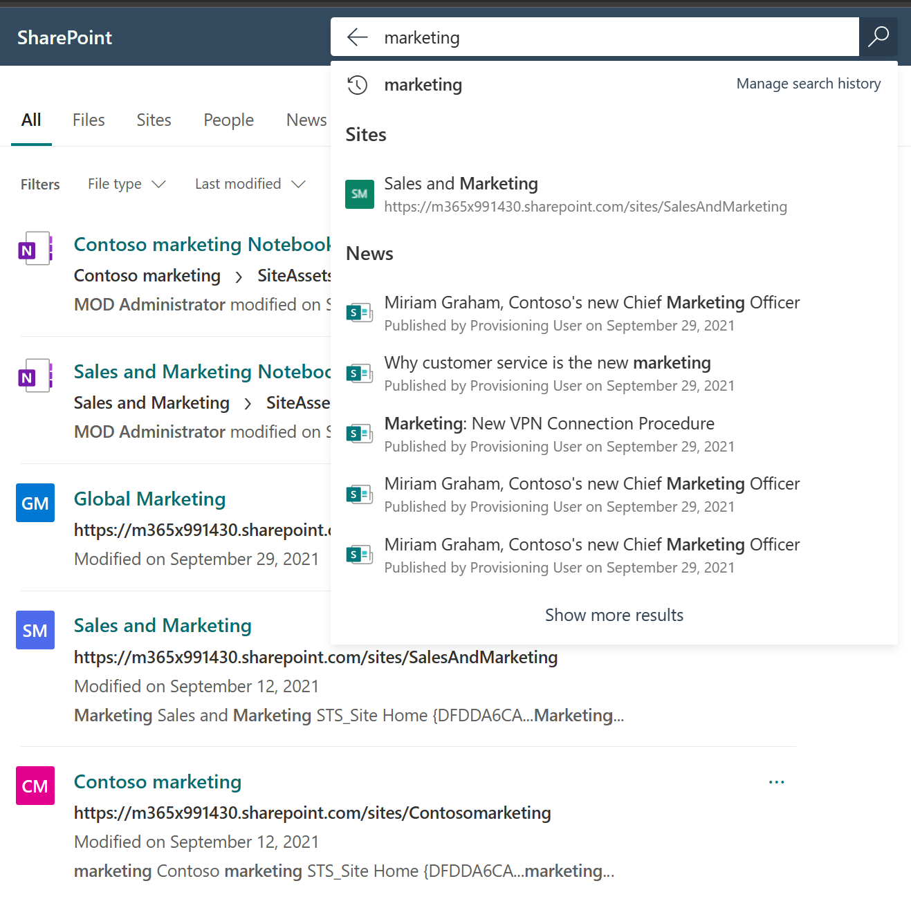
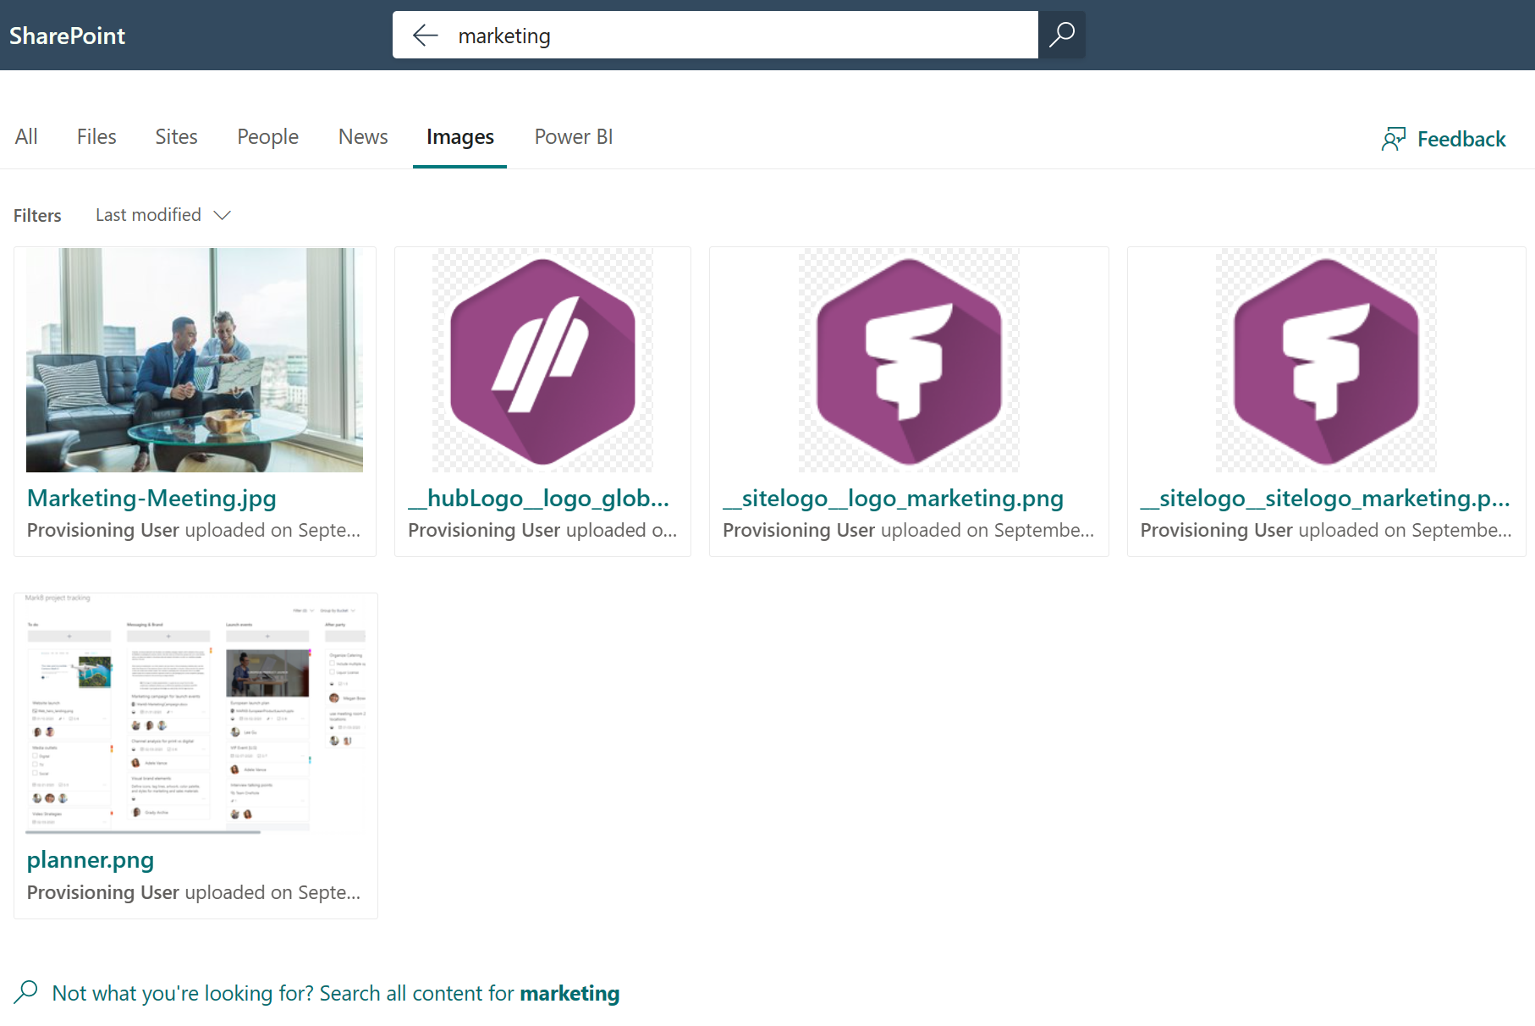
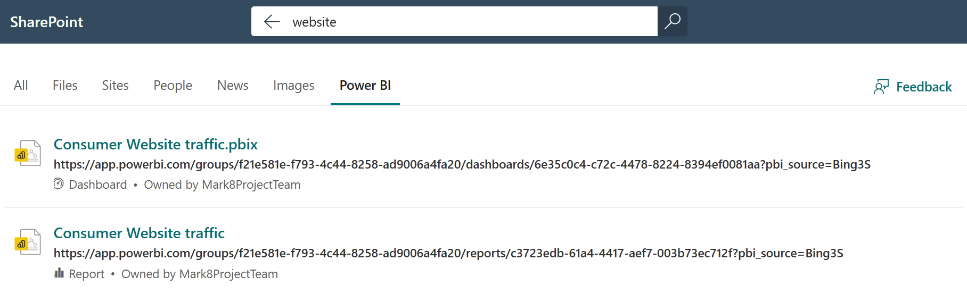
What can Microsoft Search show?
Notes:
You can search. That’s the fundamental part. But as well as the filters and groupings of content there are a few great new things. You can search your Power BI by default to get results from your data.
Search will also search in the contents of your images for the text. In the case above, the planner image contains the word marketing but nothing in the metadata at all.
Each of the tabs along the top are known as verticals and filter the content by those groupings as well as rendering content differently.

Slide 9
What can Microsoft Search show?
Answers
Bookmarks
Acronyms
Q&A
Locations
Desk locations

Slide 10
What content can be shown?
Files
Sites
Pages
Images
News
People
Power BI
Notes:
So you can search, add those custom answers and search through your Microsoft 365 content. Like those shown above.
For most people, this will be all that is needed but what if you want to add more. What if you wanted to show news from your corporate website? Or perhaps surface Dynamics or even Salesforce data?
Let’s move on to talking about ingesting content

Slide 11
Ingesting content
Notes:
This is how you can bring in your external content into your Microsoft Search index.
You may have been around the SharePoint world for a while and remember the days of FAST Search. Setting up pipelines and being able to ingest content from all over. So what can you do now?

Slide 12
Microsoft Search Architecture
Client Applications
Search Admin
Outlook/OWA
SharePoint
Office.com
Teams
Bing
Windows
Edge
Microsoft Search Service
Graph
Connectors
Ingestion Service
External Data
Sources
Azure Active Directory
External Content
SharePoint Files & Sites
Teams
Chats
Answers
Emails, Calendar
People, Tasks
Notes:
Let’s look back at that architecture again. Remember that bottom left? That’s how you can get your own content into this

Slide 13

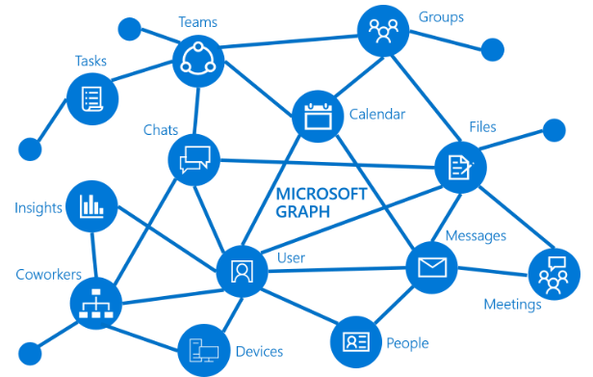



Connectors
Microsoft Graph
Notes:
The key is that the Microsoft Graph will now power extensions to your search. You can pull your own content in to Microsoft Search and add to your own area. So getting familiar with the Graph is key and I’d say critical for any future integrations with M365.

Slide 14

Microsoft Graph Connectors
{api}
Microsoft-built
connectors
Ecosystem Partner connectors
Microsoft Graph Search API
Notes:
There are three areas of the preview, the Microsoft built connectors, partner connectors and finally your own custom connectors.

Slide 15
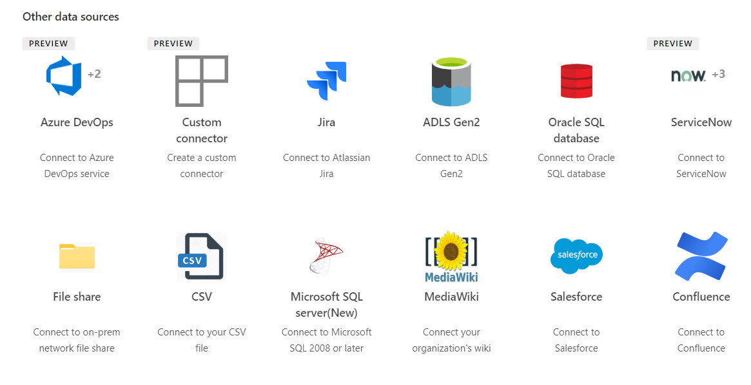
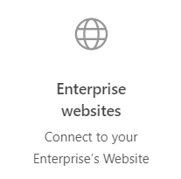
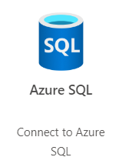
14 Microsoft-built Connectors (currently)
Notes:
Microsoft offers 7 connectors as part of the preview, allowing you to connect to some standard areas. Interestingly, while you would expect things like FileShares and possible even Data Lake, it also allows connections to custom databases with SQL, full websites, mediawiki and even ServiceNow, strengthening the partnership that Microsoft has with ServiceNow.

Slide 16
Partner Connectors
Aderant | Adobe Experience Manager | Alfresco | Alfresco Content Services | Amazon Aurora | Amazon RDS | Amazon S3 | Any SQL-based CRM system | Atlassian Confluence
Atlassian Confluence Cloud | Atlassian Jira | Azure Blob Storage | Azure Data Lake | Azure Event Hub | Azure SQL Database | Deltek | Documentum | Documentum DQL
EMC eRoom | Elastic | Elite / 3E | e-Spirit FirstSpirit | Exchange | FTP | Facebook Workplace | File Share | File System
GitLab | Google Cloud SQL | Google Docs | HDFS | HP Consolidated Archive (EAS) | Hbase | IBM Connections | IBM Connections Cloud | IBM Content Manager
IBM Db2 | IBM FileNet P8 | IBM Lotus Notes | IBM Notes | IBM WebSphere | iManage Work | JIVE | Kafka | Kinesis
LegalKEY | LDAP | LexisNexis InterAction | Lotus Notes | Lotus Notes Database | MediaPlatform PrimeTime | MediaWiki | Micro Focus Content Manager | Microsoft Azure AD
Microsoft SQL Database | Microsoft SQL Server | Microsoft SharePoint | Microsoft Windows File Server | Microsoft Yammer | MySQL | NetDocuments | Nuxeo | Objective
Microsoft OneDrive | OpenText Content Server | OpenText Documentum | OpenText Livelink/RM | OpenText eDOCS DM | Oracle Database | Oracle Knowledge Advanced Cloud | Oracle WebCenter | Oracle WebCenter Content
Pironet NDH | Pirobase CMS | PostgreSQL | RDBMS Server | RSS | Relational databases | SAP ERP | SAP HANA | SAP NetWeaver Portal
SAP PLM DMS | SMB | SMB File Share | SMTP | SharePoint 2013 | SharePoint 2016 | SharePoint Online | Sitecore | StageR
Symantec Enterprise Vault | TeamForge | Twitter | Veeva Vault | Veritas Enterprise Vault | Web Crawler | Windream ECM-System | Workplace by Facebook | Xerox DocuShare
Over 100 connectors
https://www.microsoft.com/microsoft-search/connectors
Notes:
If those don’t meet your needs, you can use some pre-built connectors from several Microsoft partners. These are likely to incur some costs but will reduce the effort needed to get started with some of these standard services like Salesforce, Twitter, and Lotus Notes. How much? You would need to check with the partners noted on the Microsoft Search Connectors page. There is also the option of building out your own connector.
Show some of the details at https://docs.microsoft.com/en-us/microsoftsearch/configure-connector

Slide 17

Demo
Adding a website
Notes:
Show the web connector as a wizard – add MVP, Lesley Crook is a Viva Visionary
Then show Twitter connector
Check out the portal at mcd79
Mention steps – next slide

Slide 18
Custom content ingestion
Notes:
So that was the standard content but how about the main topic – actually integrating your own content? I mentioned before that the process involved the Microsoft Graph and that is the key to things.

Slide 19

Custom Connector Options
Connector SDK
Simpler for devs
Focused on Line of Business (LoB) apps
Designed for hosted solutions
Search and Indexing API
More control
LoB or Cloud services
More suitable for PaaS
Build your first custom Microsoft Graph connector - Microsoft Graph | Microsoft Learn
Work with the Microsoft Graph connectors API - Microsoft Graph | Microsoft Learn
Using the Microsoft Graph connectors SDK to integrate your line of business data with Microsoft 365 - Microsoft Tech Community
Notes:
So when I first planned this session, I expected to be updating it with some content for Viva Topics. Instead, it’s a new way of connecting!
Where the search and indexing APIs were available first, it was a little complex to get started but very open. As you will see shortly, I realised that you could get it up easily into an Azure Function or a Logic App.
The Connector SDKs have come in to make it easier for devs, especially where they have a hosted line of business app on-prem. Sample code for a c# console app as well as for Go, Ruby and many others.

Slide 20
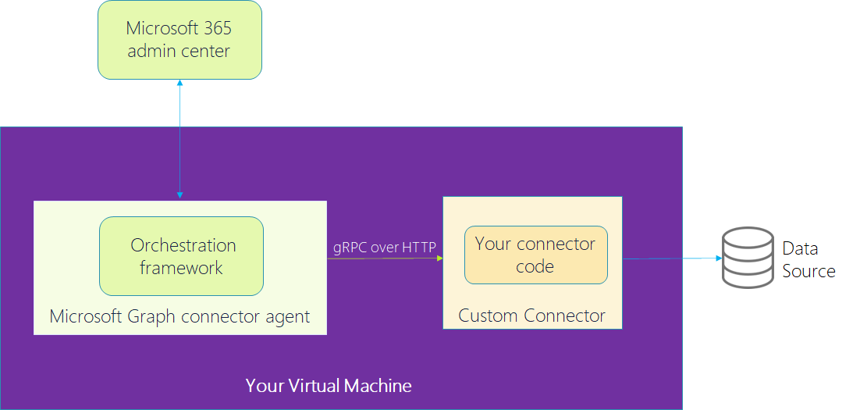
Connector SDK
microsoftgraph/msgraph-connectors-sdk (github.com)
Notes:
The connector app uses gRPC to connect to your code and then link to the data source. It requires a graph agent to be run.
I’ll be honest, this is more complex for me and when I tried it, I couldn’t compile it fully. So this will be the last I speak on this today until one of you awkward folks asks me a question!

Slide 21
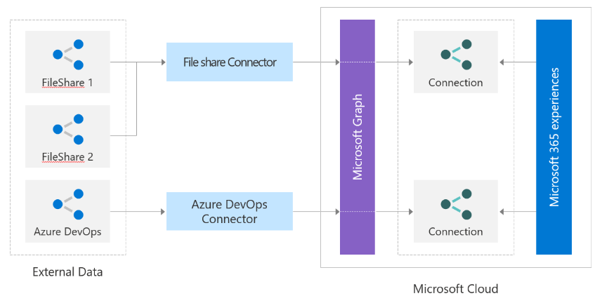
Search and indexing APIs
Notes:
Instead we have this as an examples. Setting up the connectors for fileshares, for devops or your own content. Let’s dig further into that

Slide 22
Overall process
Connector
Create connector in graph
Register
Register in search
Adaptive card
Create card for viewing
Index
Add indexes

Slide 23
Connector set up
Set up
Set up the app registration in Azure AD
Grant
Grant permissions for External Items to have Read/Write
Create
Create an External Connection giving a unique ID, name and description
Create
Create a schema for the index content and assign to the connection
externalConnection resource type - Microsoft Graph v1.0 | Microsoft Docs

Slide 24
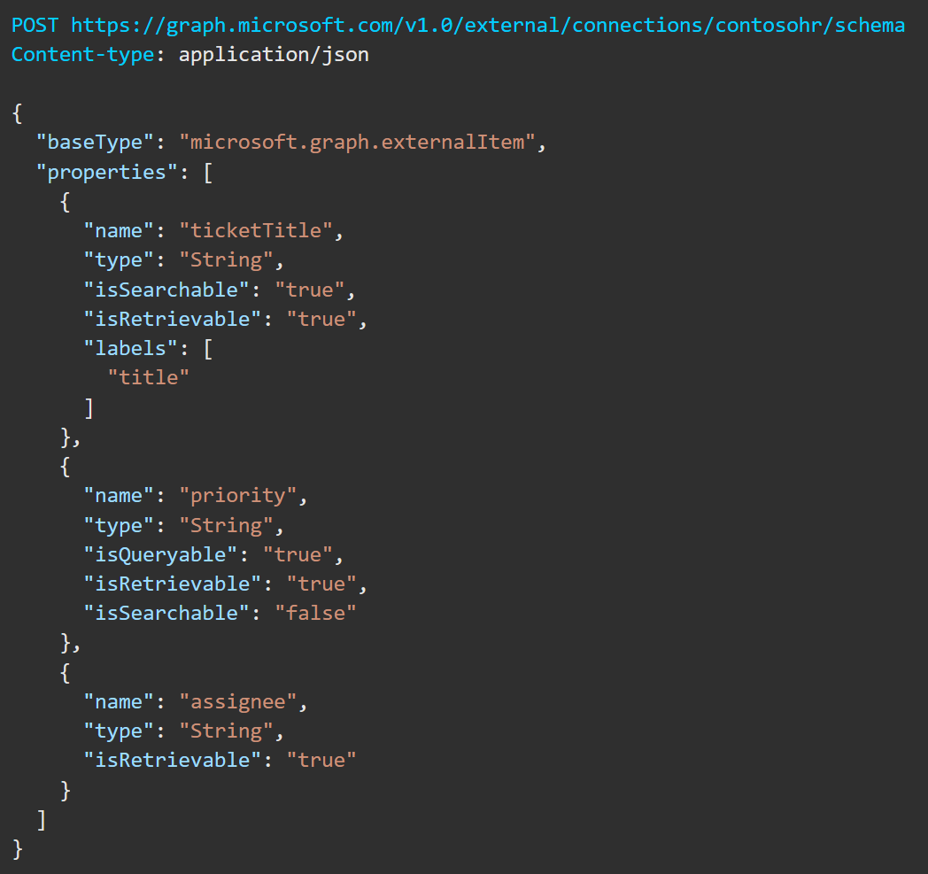
Setting up your schema
Define what will be stored
Outline data types
Outline what is returned
https://github.com/kevmcdonk/S4MSC-Twitter/blob/main/schema.json

Slide 25
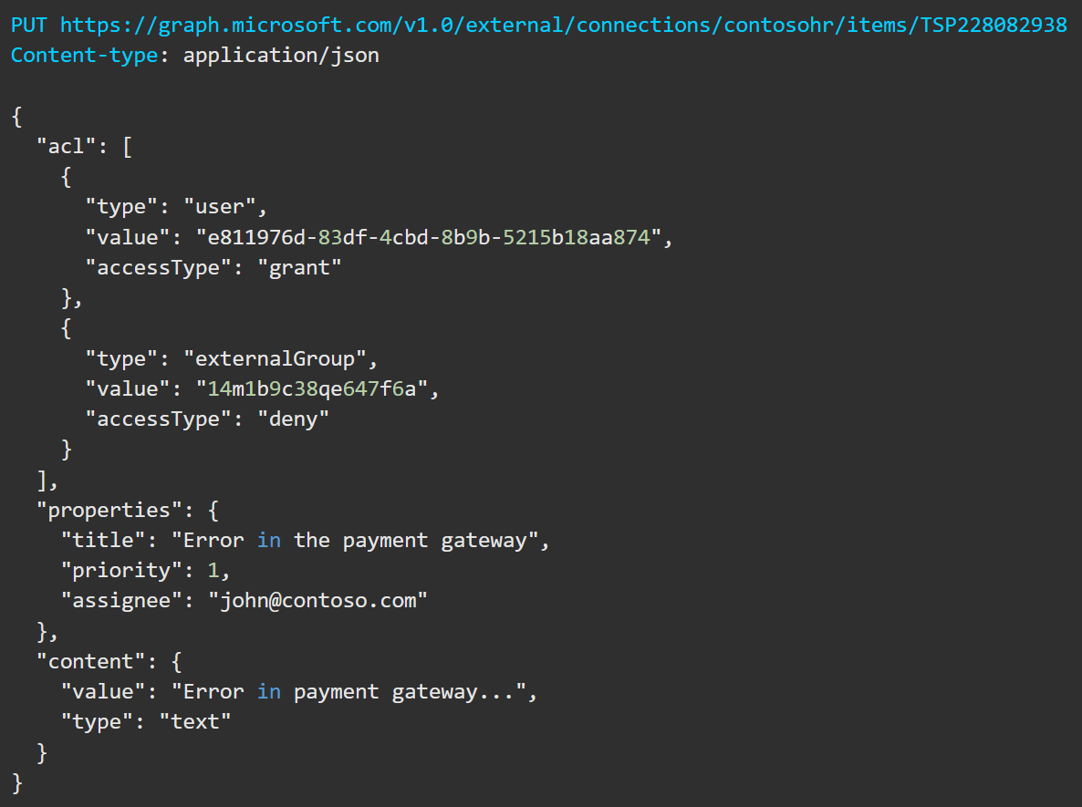
Creating items
Including defining permissions
Provide values for schema properties
Determine what permissions are set
https://github.com/kevmcdonk/S4MSC-Twitter/blob/main/Mcd79TwitterSearchCollabTalk.json

Slide 26


Implementing with Logic Apps
Microsoft Search Service
Setup
Search
Trigger
Configures the connection and required schema, more on this below.
Retrieves up to 99 tweets to pull a range of information.
Regular trigger for any new tweets with the hashtag.
Notes:
Talk about getting from Twitter and loading into search service.
One Logic App sets up the connections.
One allows an adhoc search (great for initial testing)
Final one is the main one that runs on a trigger.
Mention managed identity didn’t work
Logic Apps Designer - Microsoft Azure

Slide 27
Using CLI
Capability being added to CLI for Microsoft 365
Work in progress though!
externalconnection add - CLI for Microsoft 365 (pnp.github.io)

Slide 28
Overall process
Connector
Create connector in graph
Register
Register in search admin centre
Adaptive card
Create card for viewing
Index
Add indexes through trigger

Slide 29
Demo
Notes:
Show data source added
Talk about verticals
Talk about result sources and cards
Go back to Logic App and show there
Show results

Slide 30
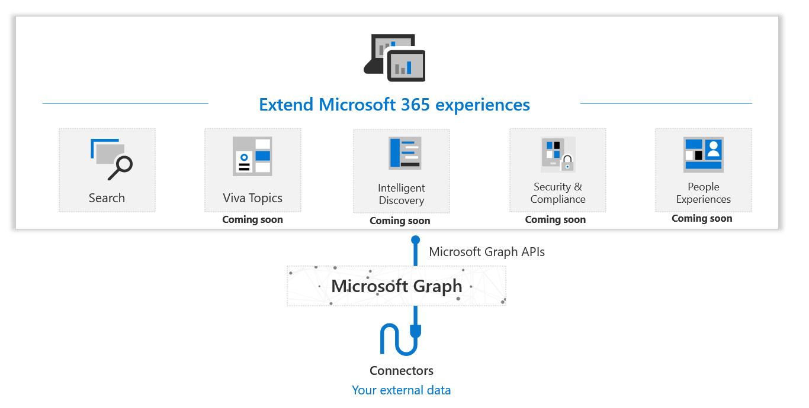
The power of graph extensions

Slide 31
The “L” Word
Microsoft Search – included in your license
Index Quota
E5 – 500 items per license (i.e. 1000 licenses = 500,000 items)
Purchase additional at around £750 per instance per month for 1 million items
Current maximum is 7 million items
https://docs.microsoft.com/en-us/microsoftsearch/licensing

Slide 32
The future
Related work search
Custom Verticals and refiners
Semantic search (GA)
Cross tenant people search
Conversations search in SharePoint and Office.com
Personal query history
Notes:
Microsoft Teams: Related work search
See what else is around your original intent.
Microsoft Search: Custom verticals and refiners
New support for custom verticals and refiners in Microsoft Search allows you to customize out of the box verticals for Microsoft Search, add custom refiners and create new verticals for SharePoint content.
Microsoft Search: Semantic search
With intelligent, natural language search capabilities in Microsoft Search, you will experience improved search accuracy as the search engine can now understand intent and contextualize the meaning of the terms typed – leading to more relevant search results.
Office 365: Cross-Tenant People Search (Limited Availability)
This feature is for customers with multiple tenants. It allows users to use People search to search across multiple tenants.
Microsoft Search: Conversation search in Office.com and SharePoint
Conversation search will allow you to find relevant Microsoft Teams, Yammer, and Outlook conversations when searching in SharePoint and Office.com.
Microsoft Search: Personal query history
As you start typing in the search box, you will see suggested searches and results based on your previous activity in Microsoft 365 and based on content that’s trending in your organization. Personal query history will show the queries you have previously used. These personal query suggestions are served from your personal search history. Personal query suggestions are a quick way to get back to results you've found before. You just need to remember the beginning of a query, after you've typed just a few characters the query is suggested for you.
Talk about Topics

Slide 33
Roadmap
Related work search
Coherent Workplace Search
Conversations Search in SharePoint and Office.com
1
3
5
2
4
6
Custom verticals and refiners
Azure Cognitive Search results in Microsoft Search
Search video transcript for Stream
Microsoft 365 Roadmap - See What's Coming | Microsoft Search
Notes:
Microsoft Teams: Related work search
See what else is around your original intent.
Microsoft Search: Custom verticals and refiners
New support for custom verticals and refiners in Microsoft Search allows you to customize out of the box verticals for Microsoft Search, add custom refiners and create new verticals for SharePoint content.
Microsoft Search: Semantic search
With intelligent, natural language search capabilities in Microsoft Search, you will experience improved search accuracy as the search engine can now understand intent and contextualize the meaning of the terms typed – leading to more relevant search results.
Office 365: Cross-Tenant People Search (Limited Availability)
This feature is for customers with multiple tenants. It allows users to use People search to search across multiple tenants.
Microsoft Search: Conversation search in Office.com and SharePoint
Conversation search will allow you to find relevant Microsoft Teams, Yammer, and Outlook conversations when searching in SharePoint and Office.com.
Microsoft Search: Personal query history
As you start typing in the search box, you will see suggested searches and results based on your previous activity in Microsoft 365 and based on content that’s trending in your organization. Personal query history will show the queries you have previously used. These personal query suggestions are served from your personal search history. Personal query suggestions are a quick way to get back to results you've found before. You just need to remember the beginning of a query, after you've typed just a few characters the query is suggested for you.
Talk about Topics

Slide 34
Thank You

Slide 35




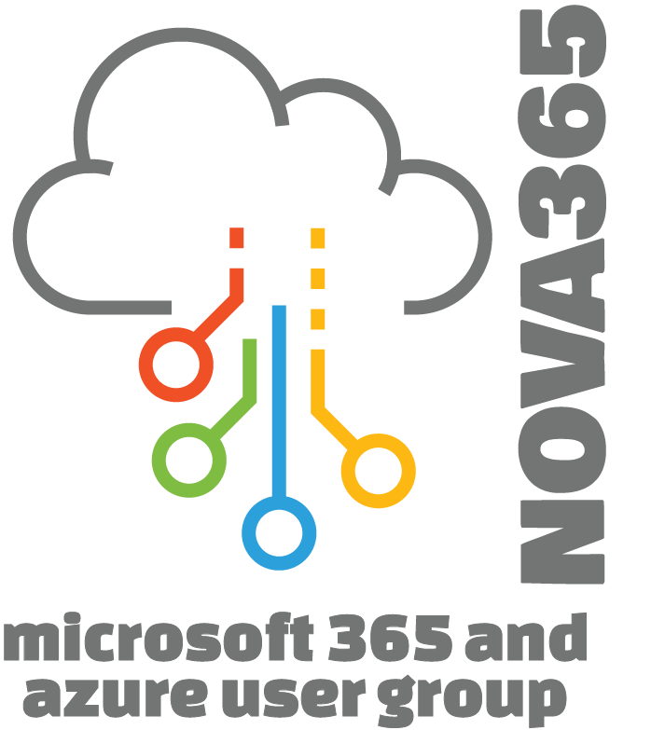




Massive Thanks to Our Sponsors!
Gold Partner
Community Partners
Silver Partners
M365 Chicago is an OTSN Conference
Chicago Power Platform Users Group
M365 Friday Cabo San Lucas

Slide 36




Raffles and Giveaways
$100 Gift Card for Opt-in Raffle
5 Winners
$250 Gift Card for Partner Raffle 2 Winners
Xbox One for Attendee Opt-in Raffle
1 Winner
Chicago Prize Pack Twitter Giveaway
1 Winner
TWITTER GIVEAWAY!!!
Tweet about the conference using #M365CHI22 for a chance to win a Chicago Prize Pack. One Winner selected at random!
OPT-IN REGISTRATION RAFFLE Did you opt-in to talk to our partners during registration? Thank you! Join us in the General Channel at 5:50 to see if you won an Opt-In Raffle prize!
PARTNER RAFFLE Please, visit our Partners! While you’re there, ask for their Special Phrase and gain an entry for our Partner Raffle prize!
Submit your Partner Raffle entries to https://otsn.live/M365Chi-SponsorContest

Slide 37

Help Us Improve Our Conference! Fill out a short speaker survey for each session you attend AND for the conference, overall!
https://otsn.live/M365CHI-Feedback
https://otsn.live/M365CHI-Feedback

Slide 38
Appendices

Slide 42
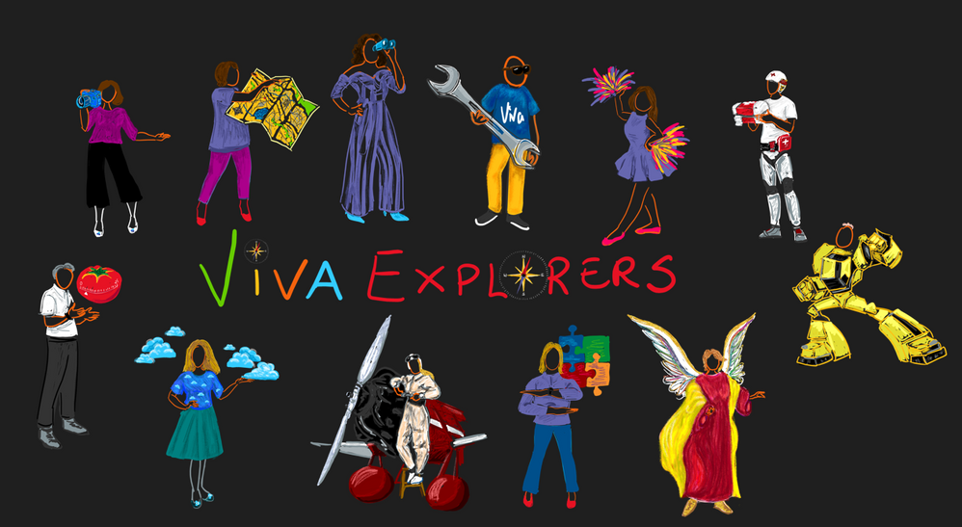
Sharing the what, the why and the how of Microsoft Viva
https://www.vivaexplorers.com
Notes:
Sara

Slide 43









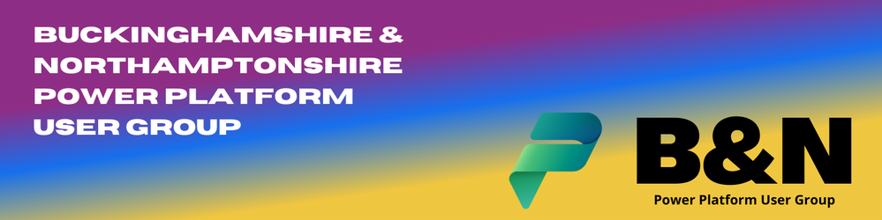

BLETCHLEY PARK 2022
Silver
Platinum
Gold
Silver
Lunch Sponsor
Community Sponsors
Thank you to all our Sponsors

Slide 44

BLETCHLEY PARK 2022
Thank You!

